Slide 1
Muhammad Ali

Slide 2
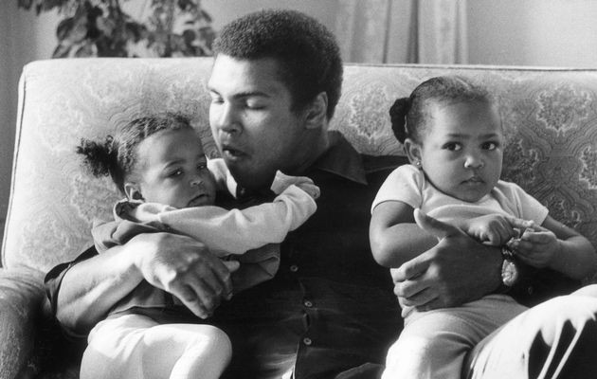
born as Cassius Marcellus Clay, Jr.
Louisville, Kentucky, 17. January 1942.
former professional American boxer
generally considered among the greatest heavyweights in the sport's history
joined Nation of Islam and changed his name
“The Greatest”
married 4 times, had 7 daughters and 2 sons

Slide 3
Early life and amateur career
he was first directed toward boxing by Louisville police officer and boxing coach Joe E. Martin
began training boxing when he was 12
his amateur record was 100 wins with five losses

Slide 4
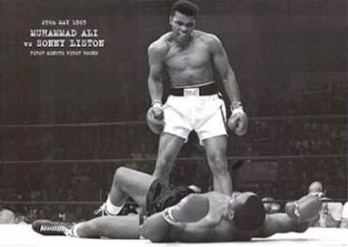
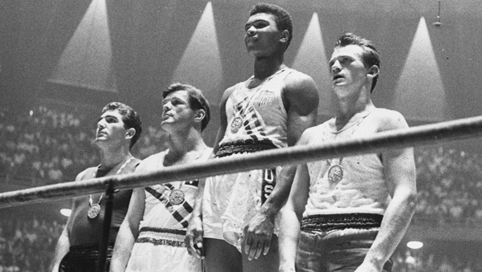
Professional boxing
made his professional debut on October 29, 1960
at the age of 22, he won the world heavyweight championship in 1964 from Sonny Liston
won a gold medal at the Rome Olympics in 1960
first boxer who won the world heavyweight title three times

Slide 5
Exile and comeback
Ali refused to be inducted into the armed forces
he was systematically denied a boxing license in every state and stripped of his passport
he didn’t fight from March 1967 to October 1970-from ages 25 to almost 29-as his case worked its way through the appeal process

Slide 6
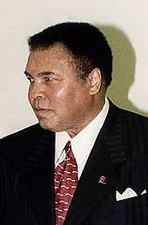
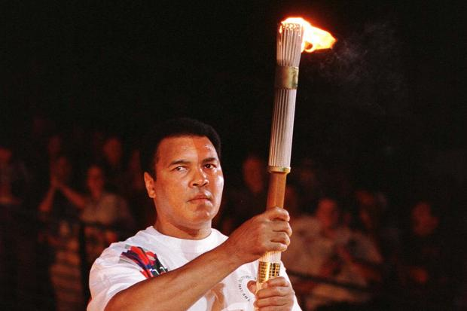
Later years
diagnosed with Parkinson's syndrome in 1984, a disease that is common to head trauma from activities such as boxing
remained active during this time, later participating as a guest referee in the WrestleMania event
he had the honor of lighting the flame at the 1996 Summer Olympics in Atlanta, Georgia

Slide 7
Boxing style
Ali had a highly unorthodox boxing style for a heavyweight - "float like a butterfly, sting like a bee“
never an overpowering puncher, Ali relied early in his career on his superior hand speed, superb reflexes and constant movement
Ali regularly taunted and baited his opponents before the fight and often during the bout itself

Slide 8
Legacy
he defeated every top heavyweight in his era, which has been called the golden age of heavyweight boxing
Ali was named "Fighter of the Year" by Ring Magazine more times than any other fighter
In 1978, three years before Ali's permanent retirement, Walnut Street was renamed to Muhammad Ali Boulevard

Slide 9
in 1993, the Associated Press reported that Ali was tied with Babe Ruth as the most recognized athlete, out of over 800 dead or alive athletes, in America
on November 19, 2005 (Ali's 19th wedding anniversary), the $60 million non-profit Muhammad Ali Center opened in downtown Louisville

