Slide 1
iPhone 7
Brand new phone!!!

Slide 2
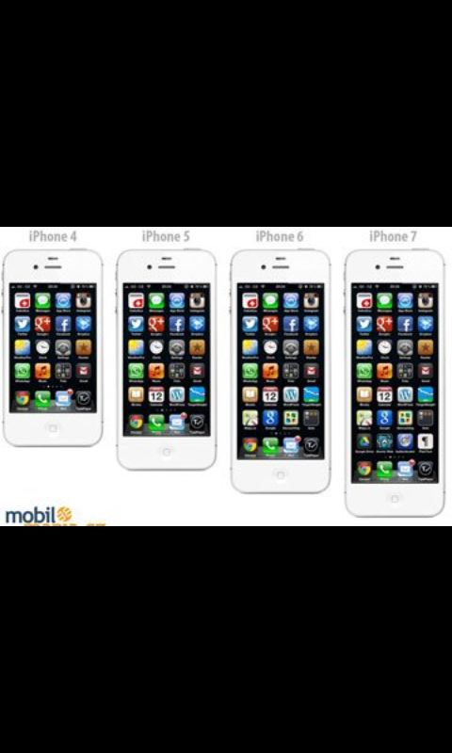
We present you iPhone 7,brand new phone! New technology,new options!
More storage,more everything!
For the past couple of years there were so many phones,but now,this one is the best.
The price is low,but the battery is high!

Slide 3
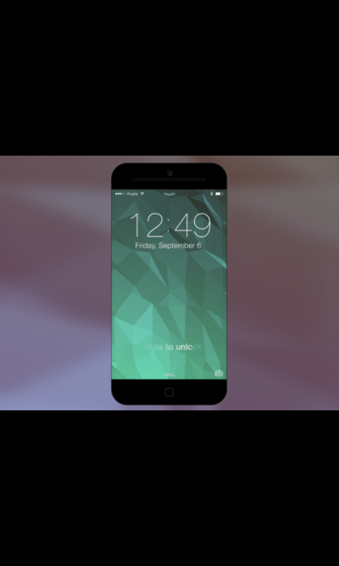
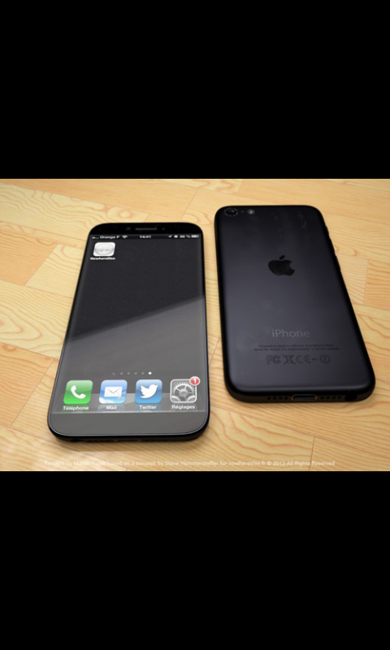
So many expectations but now here it is.
Finally,Apple made a new phone which was so expected for 2 years.
He have 10 mp which is a really good camera.
From now,you can listen your music for free without Internet!

Slide 4
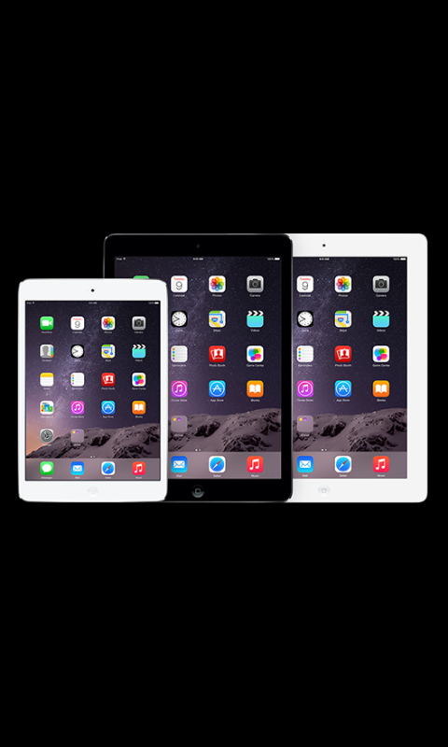
If you call us now,you can get iPad for free,you don’t have so much TIME!
Our number is 445-643.
You can also visit us in Zagreb,New York,Hong Kong…

Slide 5
DON’T FORGET,HE IS HERE,THE BRAND NEW iPhone 7!
CALL US AS SOON AS YOU CAN,VISIT US,ORDER THIS PHONE FOR JUST 200$ !!!
Apple Inc.

Slide 6
Izradile: Adriana Jakšić Antoana Zeba, 7.b

