Slide 1
Eco Bags

Slide 2
Do you want world like this?

Slide 3
Plastic bags are not good for nature. They litter our environment and kill animals .

Slide 4
Save the nature! Use eco bags!

Slide 5
So many people today go to shop with eco bags.

Slide 6
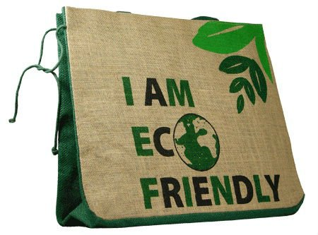
Eco bags are made of fabric. Thay can be used several times. Eco bags can recycle and we have got new eco bag.

Slide 7
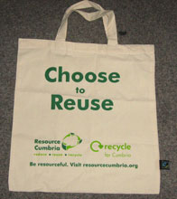
Everybody can choose to save nature.

Slide 8
Be cool, be green!

