Slide 1
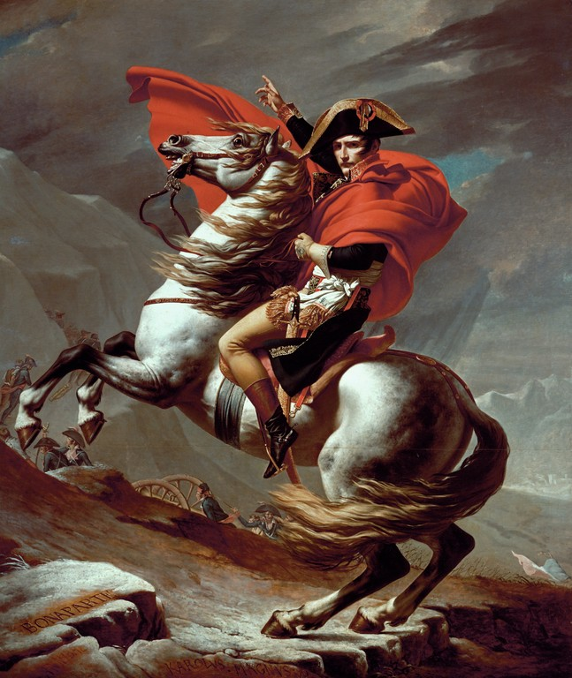
NAPOLEON BONAPARTE

Slide 2
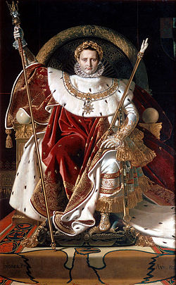
Who is Napoleon?
he was born on 15. 8. in 1769.
he was one of the most famous French military officers and emperors
first he was a general and later he grew up to a great emperor
he had a lot of war successes for France
he also had many wives

Slide 3
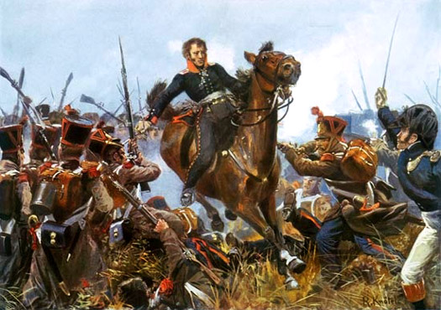
War successes
Napoleon had many battles and wars but his 7 biggest ones are:
Trafalgar 1805.
Austerlitz 1805.
Jena 1806.
Wagram 1809.
Borodino 1812.
Leipzig 1813.
Waterloo 1815.

Slide 4
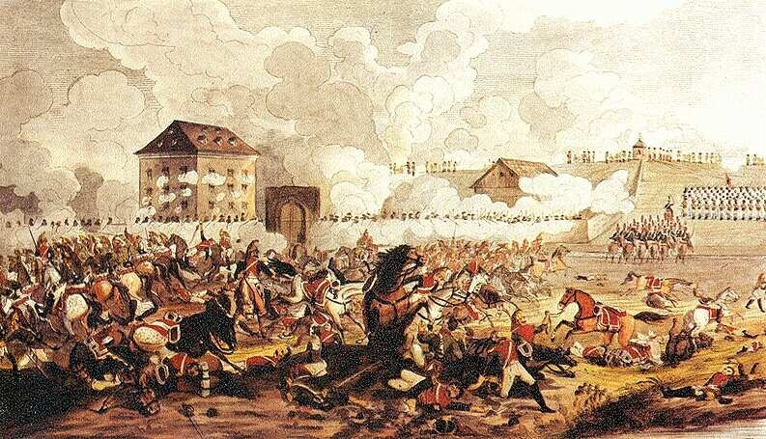
Battle near Austerlitz
it happened in 1805.
Napoleon won the battle against Austrian and Russian army
it”s second name is “The battle of the three armies”
Aleksandar I. and Franjo I. also participated

Slide 5
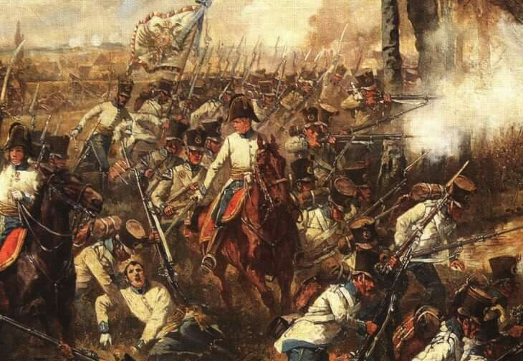
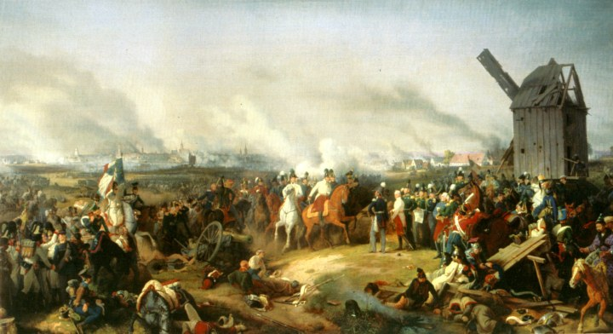
Battle near Leipzig
it happened in 1813. in Leipzig in Russia
it was his biggest defeat and after that battle he had to give up on his crown
it”s second name is “The battle of nations”

Slide 6
PREZENTACIJU IZRADILA:
☺ REA BARIŠIĆ

