Slide 1
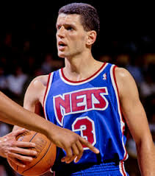
Dražen Petrović

Slide 2
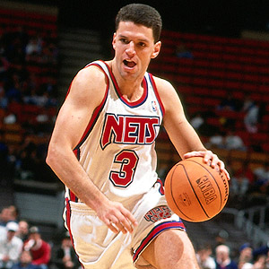
Dražen Petrović
Dražen Petrović (Šibenik October 22,1964 –June 7 1993) was a Croatian professional Basketball player.
A shooting guard,he initially achieved success playing professional basketball in europe in the 1980s,before joining the national basketball association (NBA) 1989.

Slide 3
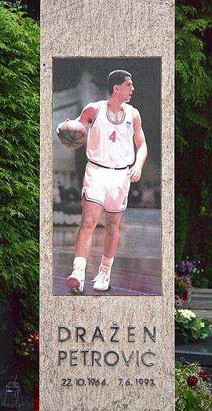
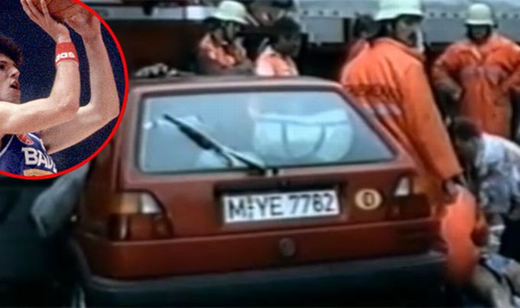
Death and legacy
Petrović died in a traffic accident at 7:20 on juni 7, 1993 four and a half months before his 29th brithday.

Slide 4
Early years
Born in šibenik , SR croatia , SFR yugoslavia.
At the age of thriteen.
Petrović started playing in the youth selection of the local club Šibenka .

Slide 6
Napravio:filip safundzić 6.a

