Slide 1
William Shakespeare

Slide 2
William Shakespeare
William Shakespeare was born in Stratford-upon-Avon in England in 1564, during the reign of Queen Elizabeth I.
Shakespeare he went to school in his hometown
Mother´s name was Mary Shakespeare
Dad´s name was John Shakespeare
In 1582 at the age of 18, he married Anne Hathaway
Get the twins named Hamnet and Judith
Shakespeare

Slide 4
Works of literature
He had an amazing influence on our English language
Along with acting, he also wrote some of the most renowned and studied literature written in the English language
Poems-famous for his sonnets
Plays-Comedies, tragedies and histories
English poet playwright 38 players, 154 sonnets plays performed more often than those of any other playwright

Slide 5
COMEDIES
As you like It
Comedy of errors
Midsummer night´s dream
Twelfth night
All´s well that ends well

Slide 6
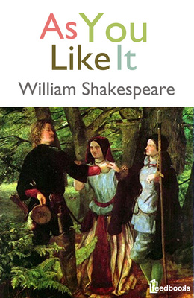

Slide 8
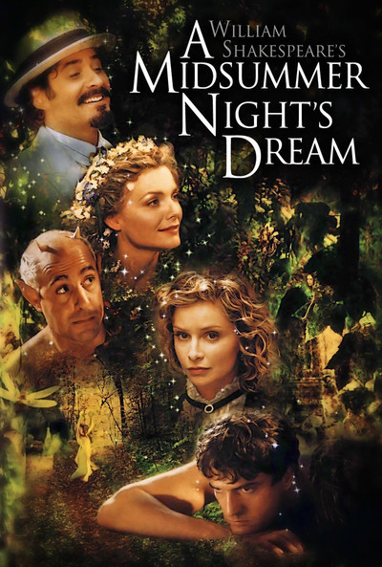

Slide 9
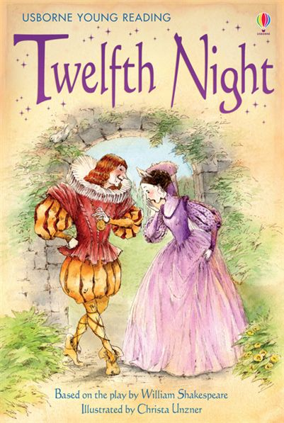
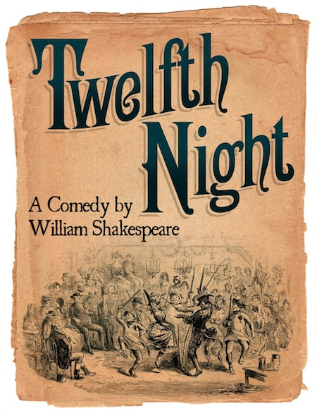

Slide 10
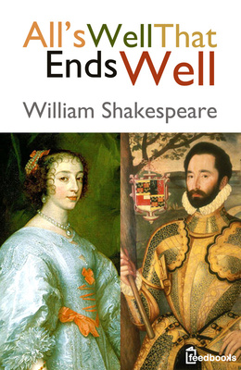
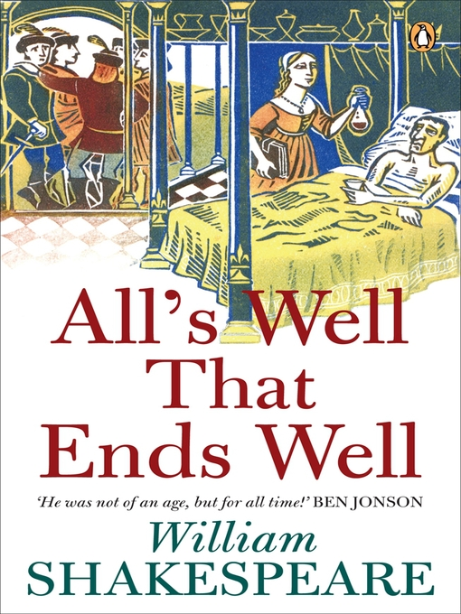

Slide 11
TRAGEDIES
Julius Caesar
Hamlet
Macbeth
Othello
Romeo and Juliet
King Lear

Slide 12
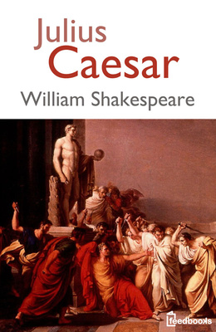

Slide 13
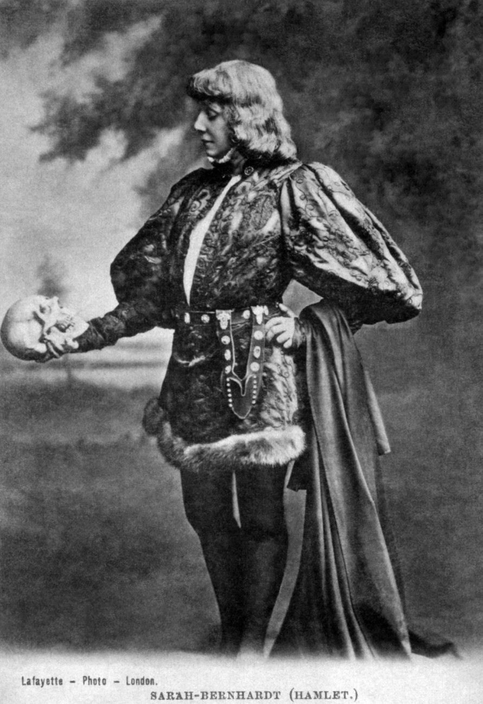

Slide 14
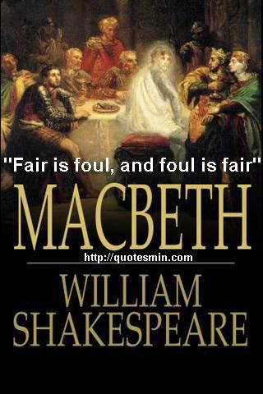

Slide 15
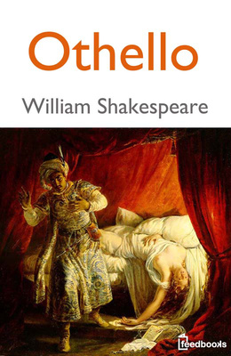
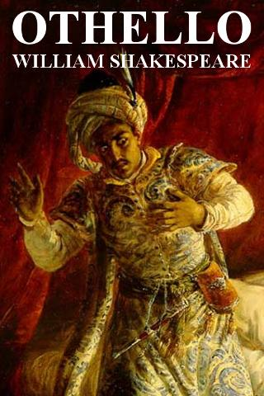

Slide 16
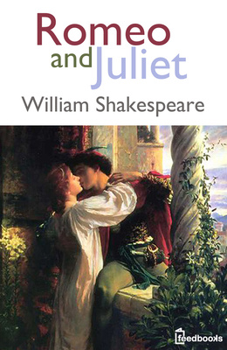
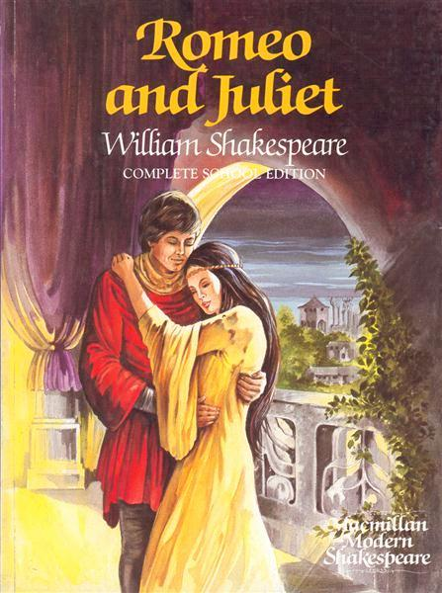

Slide 17
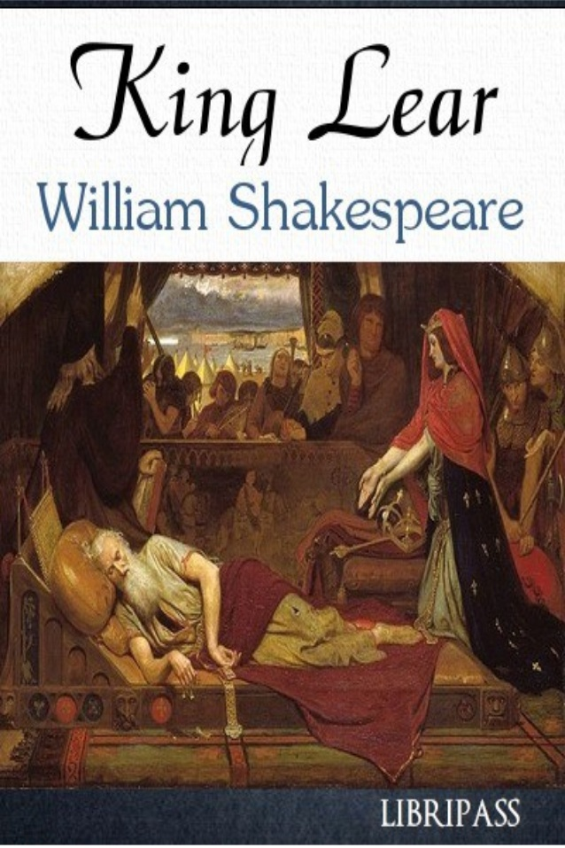
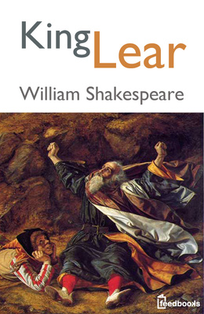

Slide 18
Histories
King Henry V
King John
Richard II
Richard III

Slide 19
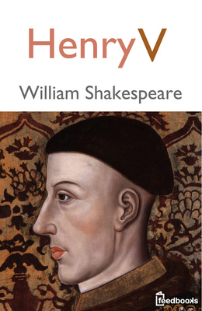

Slide 20
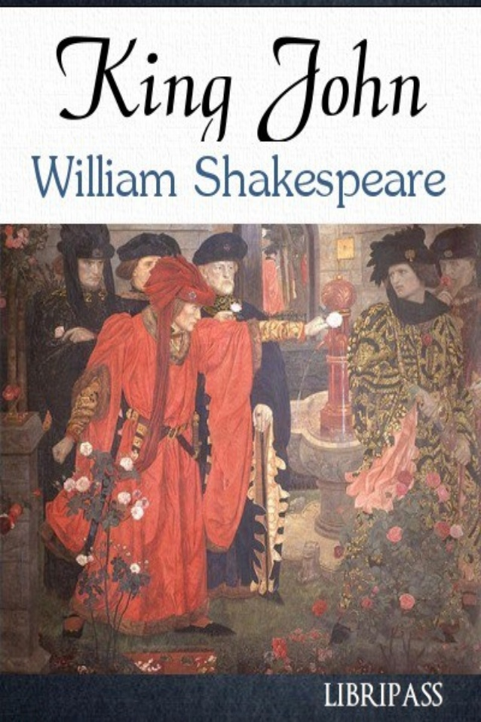
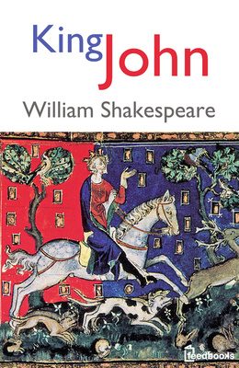

Slide 21
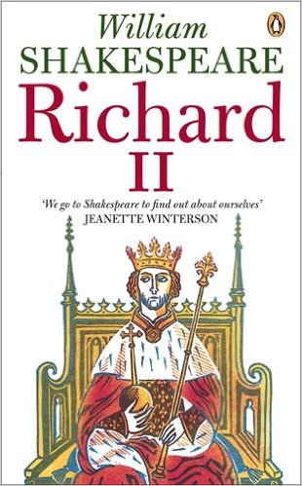
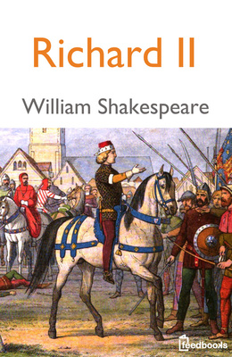

Slide 22
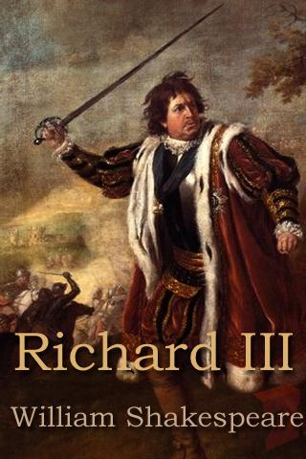
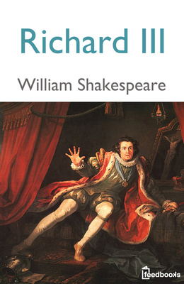

Slide 23
Globe theater
Located just outside of London.
Attending Shakespeare´s theater was quite different from attending theater today, which is thoufht of as very quiet and austere .
In Elizabethan England it wos a noisy, popular gathering for people of all ages and from all walks of life.

Slide 24
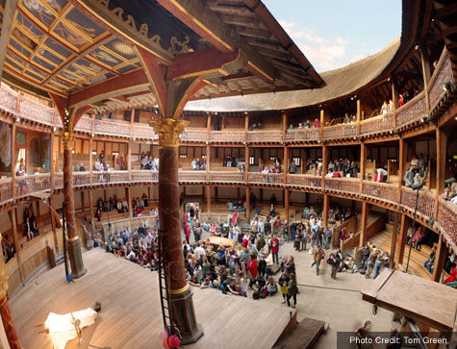
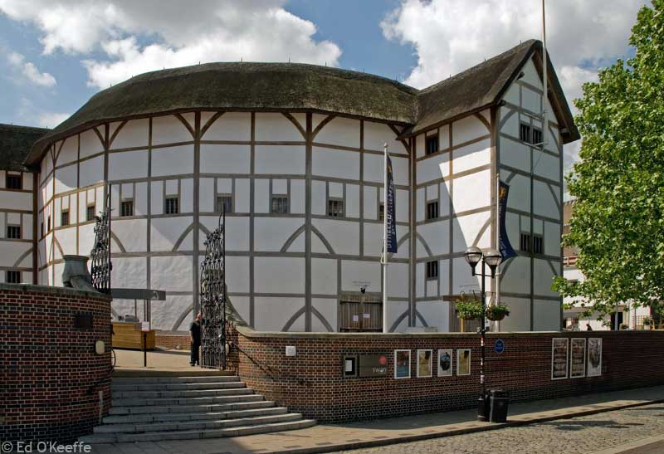
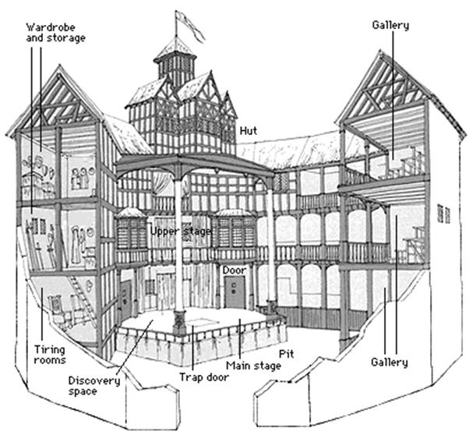

Slide 25
THE END
Martina Marijić
Mateja Marijić
Patricia Horvat
8.A

